Slide 1
CAREERS IN THE TECH INDUSTRY
Adam Stoffel

Slide 2
WHO I AM
Adam Stoffel
Application Development Consultant
Microsoft Public Sector Solutions Center
Vice President for Information Technology
Out in Science, Technology, Engineering, and Mathematics

Slide 3
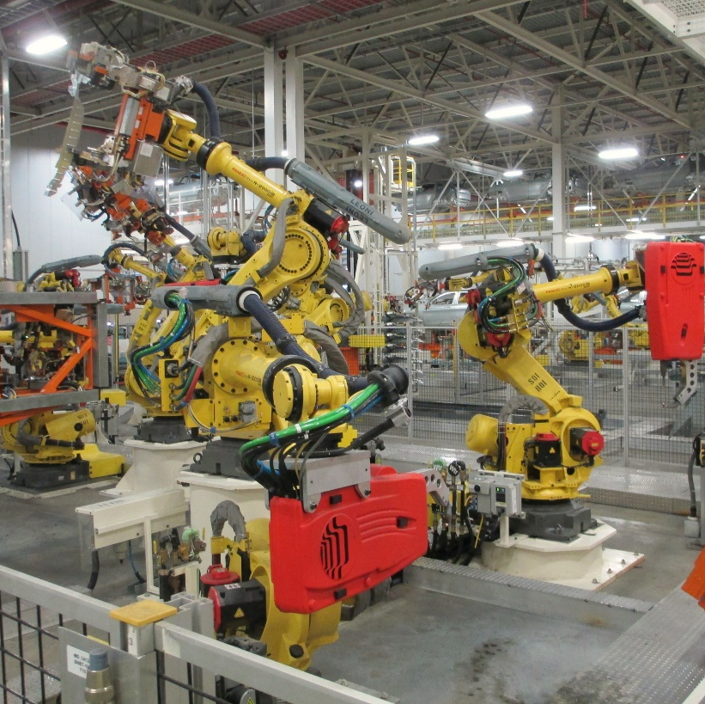
WHAT’S HAPPENING IN TECH TODAY?
DEVICES
Notes:
https://flic.kr/p/djZG8c
https://flic.kr/p/pv4qKv
https://flic.kr/p/nDgEfD
https://flic.kr/p/axB3C8
https://flic.kr/p/nsXJXS
https://flic.kr/p/o4UGNH

Slide 4
WHAT’S HAPPENING IN TECH TODAY?
DATA COLLECTION
COMPUTATION & ANALYSIS
BUSINESS INTELLIGENCE

Slide 5
WHAT’S HAPPENING IN TECH TODAY?
CLOUD
DATA
MACHINE
LEARNING
OPEN
DATA

Slide 6
TYPES OF CAREERS IN TECH
RESEARCH Data scientist Research technologist
PRODUCT DEVELOPMENT & IT Data architect Software engineer Test engineer Product manager
CUSTOMER-FACING Technical sales Professional services (consulting & support)

Slide 7
WHAT IS THE TECH INDUSTRY LOOKING FOR?
INNOVATION
COMMUNICATION
PASSION

Slide 8
HOW CAN YOU PREPARE?
Maintain and improve your coding skills
Stay up-to-date on industry trends and opportunities
Understand potential employers’ mission and values
Have a tailor-made resume for every job application
Practice explaining technical concepts to non-technical people
Leverage your network to find the right opportunities

Slide 9
STAY IN TOUCH
{
@microsoft.com
@ostem.org
adam.stoffel

